Slide 1


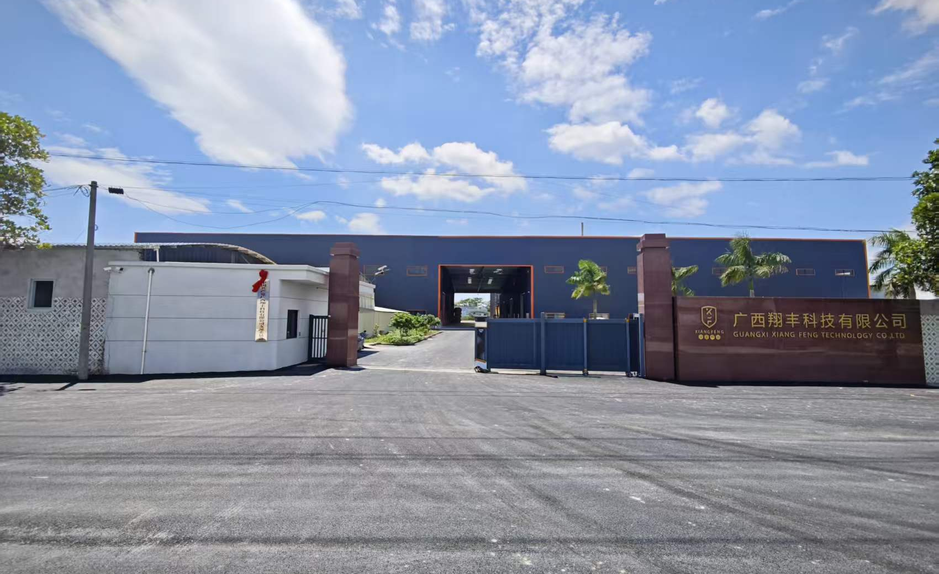
Visit our website ↗
XIANGFENG TECHNOLOGY
www.gx-xiangfeng.com
Guangxi Xiangfeng
Technology Co., Ltd.
Company Profile
EPP / EPO Foam Products
Tooling & Custom Manufacturing
20,000+ m²
RMB 30M
Site area
Fixed assets
Guangxi manufacturing base in full production
Guangxi Xiangfeng Technology Co., Ltd.
01
Notes:
来源：用户提供的广西翔丰科技有限公司.pptx、翔丰科技简介(6).docx与供应商基本信息调查表-广西.xlsx。用户确认：现已投产，占地15000㎡，固定资产3000万元。

Slide 2
COMPANY PROFILE
XIANGFENG
EPP / EPO manufacturing base in operation
Based in Wendi Industrial Park, Bobai, Yulin, Guangxi, the company builds on Guangzhou Xiangfeng's tooling and foam manufacturing experience, covering foam product development, aluminum alloy tooling and volume production.
20,000+ m²
30
16
50+
site area
RMB million in fixed assets
molding machines
employees
Business foundation
Production resources
Service team
Dedicated tooling and foam workshops serve model aircraft, UAVs, automotive components and custom protective packaging.
Molding machines and large CNC equipment support tooling, mold trials and production. Mold and machine compatibility is confirmed for each product.
Sales, engineering, production and quality work together with professional inspectors. Service requests and complaints receive a response within 48 hours.
Guangxi Xiangfeng Technology Co., Ltd.
02
Notes:
来源：用户提供的广西翔丰科技有限公司.pptx、翔丰科技简介(6).docx与供应商基本信息调查表-广西.xlsx。面积资产为用户最新口径；16台成型设备、50多名员工见简介。

Slide 3
DEVELOPMENT
XIANGFENG
Guangzhou experience, Guangxi manufacturing
The Guangxi base carries forward Guangzhou Xiangfeng's technical experience and customer relationships in foam product development and manufacturing.
Guangzhou Xiangfeng
August 2023
2026
Tooling and foam molding expertise
Model aircraft, UAV and packaging customers
Project agreement signed
Wendi Industrial Park, Bobai County
Trial production began in February
Now in full production
Technical continuity
Production capacity
Customer collaboration
Tooling, mold trial and manufacturing experience informs the assessment of new customer projects.
The Guangxi site's space and equipment support foam molding and related production activities.
Existing relationships continue, with supply scope and delivery requirements agreed for each project.
Guangzhou-era relationships and current Guangxi operations are distinguished. Contract documents determine the contracting and supplying entities.
Guangxi Xiangfeng Technology Co., Ltd.
03
Notes:
来源：用户提供的广西翔丰科技有限公司.pptx、翔丰科技简介(6).docx与供应商基本信息调查表-广西.xlsx。不将迁建计划投资额当作已完成固定资产。

Slide 4
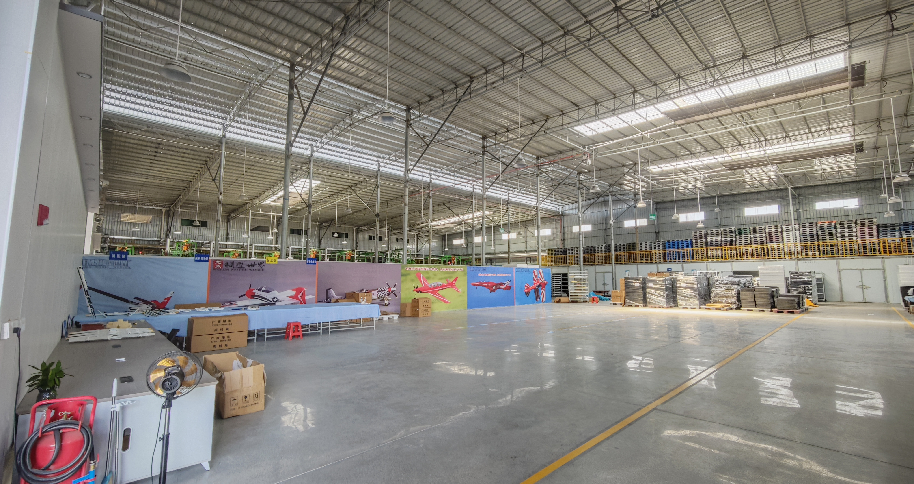
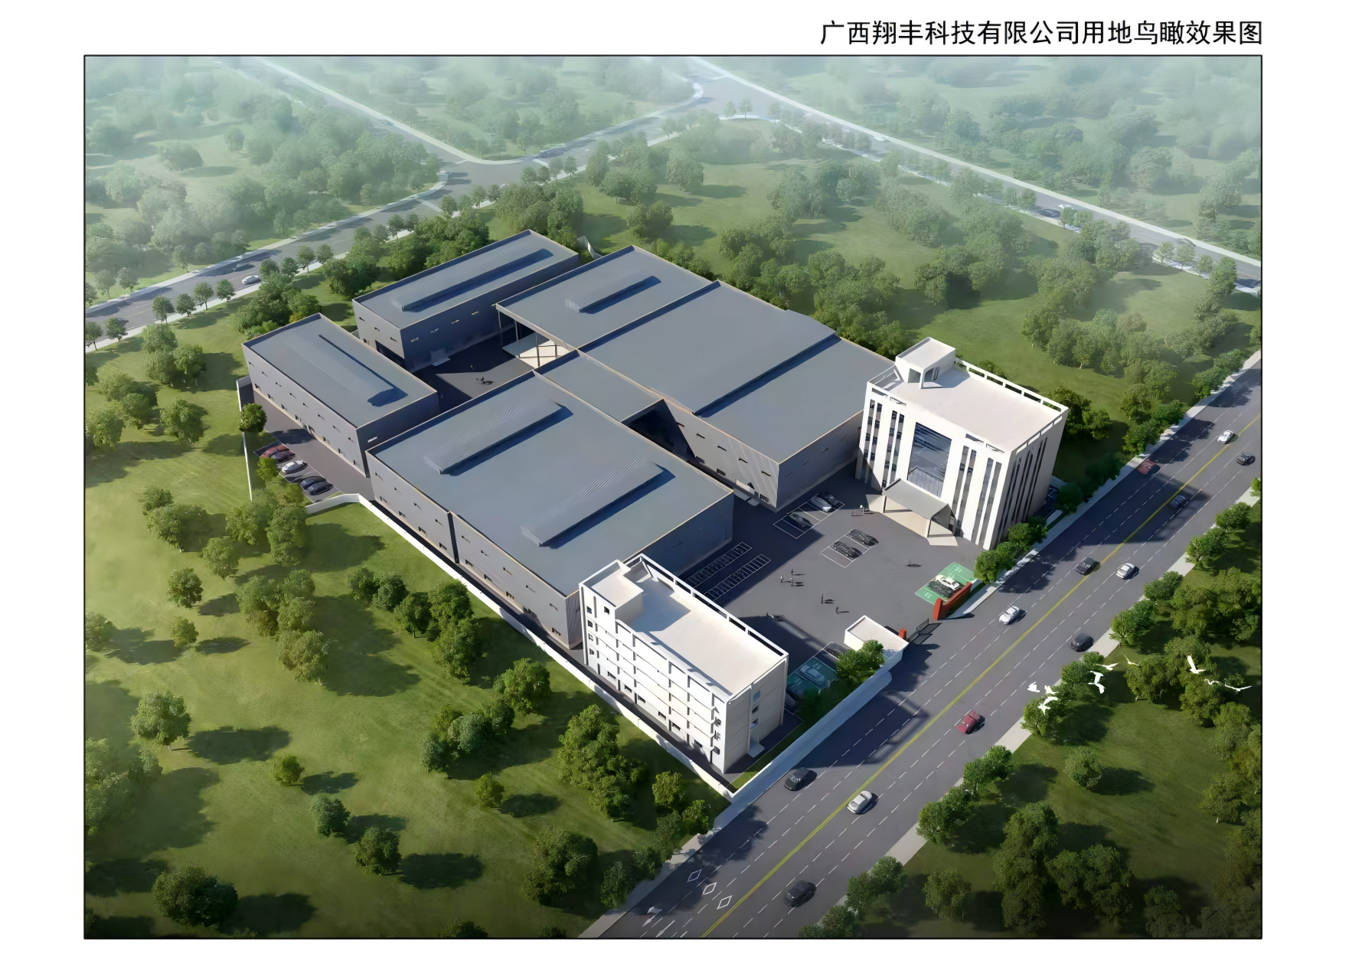
MANUFACTURING BASE
XIANGFENG
Factory space and site management
Factory planning rendering
20,000+ m²
Inside the production workshop
Site area of the operating base
The factory provides space for molding, product finishing and material handling. Signs, defined work areas and organized materials support orderly production.
Guangxi Xiangfeng Technology Co., Ltd.
04
Notes:
来源：用户提供的广西翔丰科技有限公司.pptx、翔丰科技简介(6).docx与供应商基本信息调查表-广西.xlsx。效果图为规划图，宣传图4.jpg为现有厂房实景。

Slide 5
ORGANIZATION
XIANGFENG
Organization and responsibilities
General Manager / Management
Business planning, resource allocation and quality objectives
Sales
Engineering & Tooling
Production
Quality
Warehouse & Logistics
Admin & Finance
Customer requirements
Product design assessment
Planning and scheduling
Incoming inspection (IQC)
Receiving and storage
Training and administration
Quotes and order follow-up
Mold design and machining
Molding and post-treatment
In-process inspection (IPQC)
Inventory and lot control
Resources and purchasing
Delivery coordination
Mold trials and process approval
Equipment checks and upkeep
Final / outgoing inspection
Picking and packing handover
Cost and financial management
Service and feedback
Drawings and design changes
Operations and site management
Quality systems and improvement
Dispatch and logistics
Policies and support services
Department coordination
Requirements → Engineering → Production → Quality release → Delivery
Responsibilities cover requirements, development, manufacturing, inspection and delivery. Tasks follow the actual allocation of roles.
Guangxi Xiangfeng Technology Co., Ltd.
05
Notes:
来源：用户提供的广西翔丰科技有限公司.pptx、翔丰科技简介(6).docx与供应商基本信息调查表-广西.xlsx。六部门架构经用户确认；本次按用户要求细化职能，不显示个人姓名。下列为部门职能划分，非新增人员编制。

Slide 6
PROJECT COLLABORATION
XIANGFENG
Project coordination and accountability
Each project defines who approves, who executes and what must be delivered, reducing gaps in communication between departments.
Department | Main coordination scope | Suggested project records
Sales | Application, quantity, commercial terms and delivery | Requirements list, order details and customer approval
Engineering & Tooling | Design assessment, mold development and process trials | Drawing revisions, trial records and process requirements
Production | Scheduling, equipment preparation and work execution | Work orders, production lots, quantities and progress
Quality | Inspection criteria, issue analysis and product release | First-article, patrol and outgoing inspection records
Warehouse & Logistics | Material status, packaging labels and dispatch planning | Material issue, storage, packing and dispatch records
Admin & Finance | Personnel, resources and financial coordination | Internal support, resources and settlement information
Coordination framework: follow actual job responsibilities and the project requirements agreed by both parties.
Guangxi Xiangfeng Technology Co., Ltd.
06
Notes:
来源：用户提供的广西翔丰科技有限公司.pptx、翔丰科技简介(6).docx与供应商基本信息调查表-广西.xlsx。基于用户确认的组织结构设计的协同方案，不冒充已实施制度。

Slide 7
BUSINESS SCOPE
XIANGFENG
Business scope and customer deliverables
EPP / EPO foam products and aluminum alloy tooling provide a manufacturing base for a range of product designs.
Model aircraft & UAVs
Protective packaging
Airframes and related foam components, with attention to low weight, contours, assembly interfaces and dimensional consistency.
Custom inserts, containers and protective packaging. Support and cushioning depend on the item's shape, weight and handling requirements.
Automotive & functional parts
Tooling & development
Automotive parts, complex shapes and functional products. Drawings define geometry, assembly, loads and operating conditions.
Mold design, CNC machining and trial adjustments support custom projects, from drawing review and sample approval to volume production.
The agreed documents define the products supplied, materials and acceptance criteria.
Guangxi Xiangfeng Technology Co., Ltd.
07
Notes:
来源：用户提供的广西翔丰科技有限公司.pptx、翔丰科技简介(6).docx与供应商基本信息调查表-广西.xlsx。

Slide 8
MATERIALS
XIANGFENG
EPP and EPO: materials and applications
Material names are a starting point. Final performance also depends on grade, molded density, design and processing conditions.
Comparison | EPP | EPO (model aircraft industry term)
Material meaning | Expanded polypropylene A polyolefin foam material | Usually an expanded polyolefin system Confirm composition against manufacturer data
Typical priorities | Low weight, cushioning, energy absorption and resilience Moldable into complex structures | Low weight, impact resistance and molded appearance For fuselages, wings and other model aircraft parts
Applications | Reusable protective packaging and automotive parts Thermal insulation and functional components | Model aircraft fuselages, wings and tailplanes and related model components
Selection criteria | Density, compression properties and geometry Special properties and service conditions | Specific grade and reinforcement design Surface treatment and adhesive compatibility
EPO supplier
JSP. Confirm performance and processing against the grade's TDS / SDS and approved samples.
Industry references: KANEKA and FMS. Confirm composition, properties and processing methods against the specific grade and manufacturer documentation.
Guangxi Xiangfeng Technology Co., Ltd.
08
Notes:
行业技术参考，不代表广西翔丰已确认的材料牌号、工艺参数、检测能力或认证。具体产品按原厂TDS/SDS、客户图纸和试产结果确认。
参考资料（2026-09-22查阅）：
https://www.kaneka.com.my/product/expandable-foam/
https://support.fmshobby.com/hc/en-us/articles/28297346222484-FMS-EPO-Foam-Expanded-Polyolefin-in-RC-Aircraft-Models
https://www.fmshobby.com/es/blogs/rc-airplanes/best-beginner-rc-plane-selection-guideEPP本身属于聚烯烃体系，不将EPP与EPO视为化学上完全互斥的两类。用户补充确认：EPO原料由杰斯比提供；具体牌号及实际工艺参数尚未提供。

Slide 9
MATERIAL SELECTION
XIANGFENG
Material selection and specifications
Define material and design from actual use requirements, then validate samples. Specifications need more than terms such as light, rigid or impact-resistant.
Selection factor | Items to confirm | Effect on product performance
Density & weight | Target molded density, part weight and permitted variation | Balance weight and support against compression behavior and design
Beads & geometry | Bead size, thin walls, deep cavities and local features | Affects filling feasibility, surface finish and feature definition
Loads & reuse | Loads, impact conditions and number of reuse cycles | Validate cushioning and recovery under service conditions
Appearance & fit | Color, parting lines, critical dimensions and interfaces | Confirm appearance samples and dimensional acceptance datums
Special functions | Flame resistance, antistatic and weathering requirements | Select a suitable grade and verify applicable reports
Bead bulk density ≠ Molded part density
Specify functional requirements.
Industry reference: JSP grade data. Bulk bead density and molded part density measure different things. Material names alone do not guarantee special properties.
Guangxi Xiangfeng Technology Co., Ltd.
09
Notes:
行业技术参考，不代表广西翔丰已确认的材料牌号、工艺参数、检测能力或认证。具体产品按原厂TDS/SDS、客户图纸和试产结果确认。
参考资料（2026-09-22查阅）：
https://www.arpro.com/product/technical-resources/technical-document-listing
https://www.arpro.com/getContentAsset/648e1b52-840b-4264-8b2f-6cc4f401d127/1771ac74-d775-4539-b7e3-0cbf0ab84455/arpro-5130-datasheet-v09-en.pdf?language=en-GB
https://www.arpro.com/contentassets/9fb5fdf034884d72953cea3c5a70d3ad/arpro-5150-datasheet-v05-en.pdf
https://www.basf.com/dk/en/media/news-releases/2020/03/p-20-157选型表为技术沟通建议，不构成翔丰对特殊牌号的供货承诺。

Slide 10

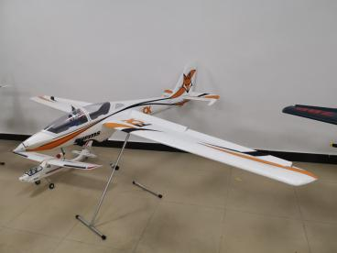
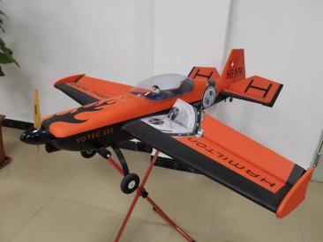
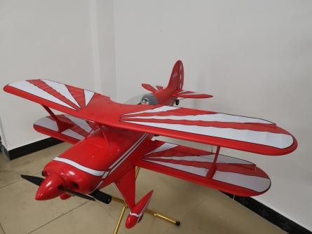
MODEL AIRCRAFT
XIANGFENG
Model aircraft products and structures
280 to
3,000 mm
Wingspan range listed in company materials
Key project requirements
Fuselage and wing contours, reinforcement and connection locations, critical dimensions, weight and appearance.
Complete aircraft performance requires validation of the structure, propulsion and control systems.
Guangxi Xiangfeng Technology Co., Ltd.
10
Notes:
来源：用户提供的广西翔丰科技有限公司.pptx、翔丰科技简介(6).docx与供应商基本信息调查表-广西.xlsx。翼展范围280至3000毫米；照片来自原PPT。行业技术参考，不代表广西翔丰已确认的材料牌号、工艺参数、检测能力或认证。具体产品按原厂TDS/SDS、客户图纸和试产结果确认。
参考资料（2026-09-22查阅）：
https://support.fmshobby.com/hc/en-us/articles/28297346222484-FMS-EPO-Foam-Expanded-Polyolefin-in-RC-Aircraft-Models
https://www.fmshobby.com/es/blogs/rc-airplanes/best-beginner-rc-plane-selection-guide

Slide 11
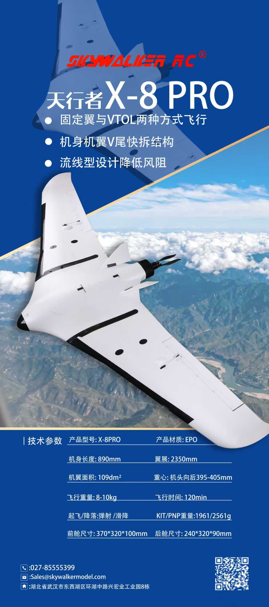
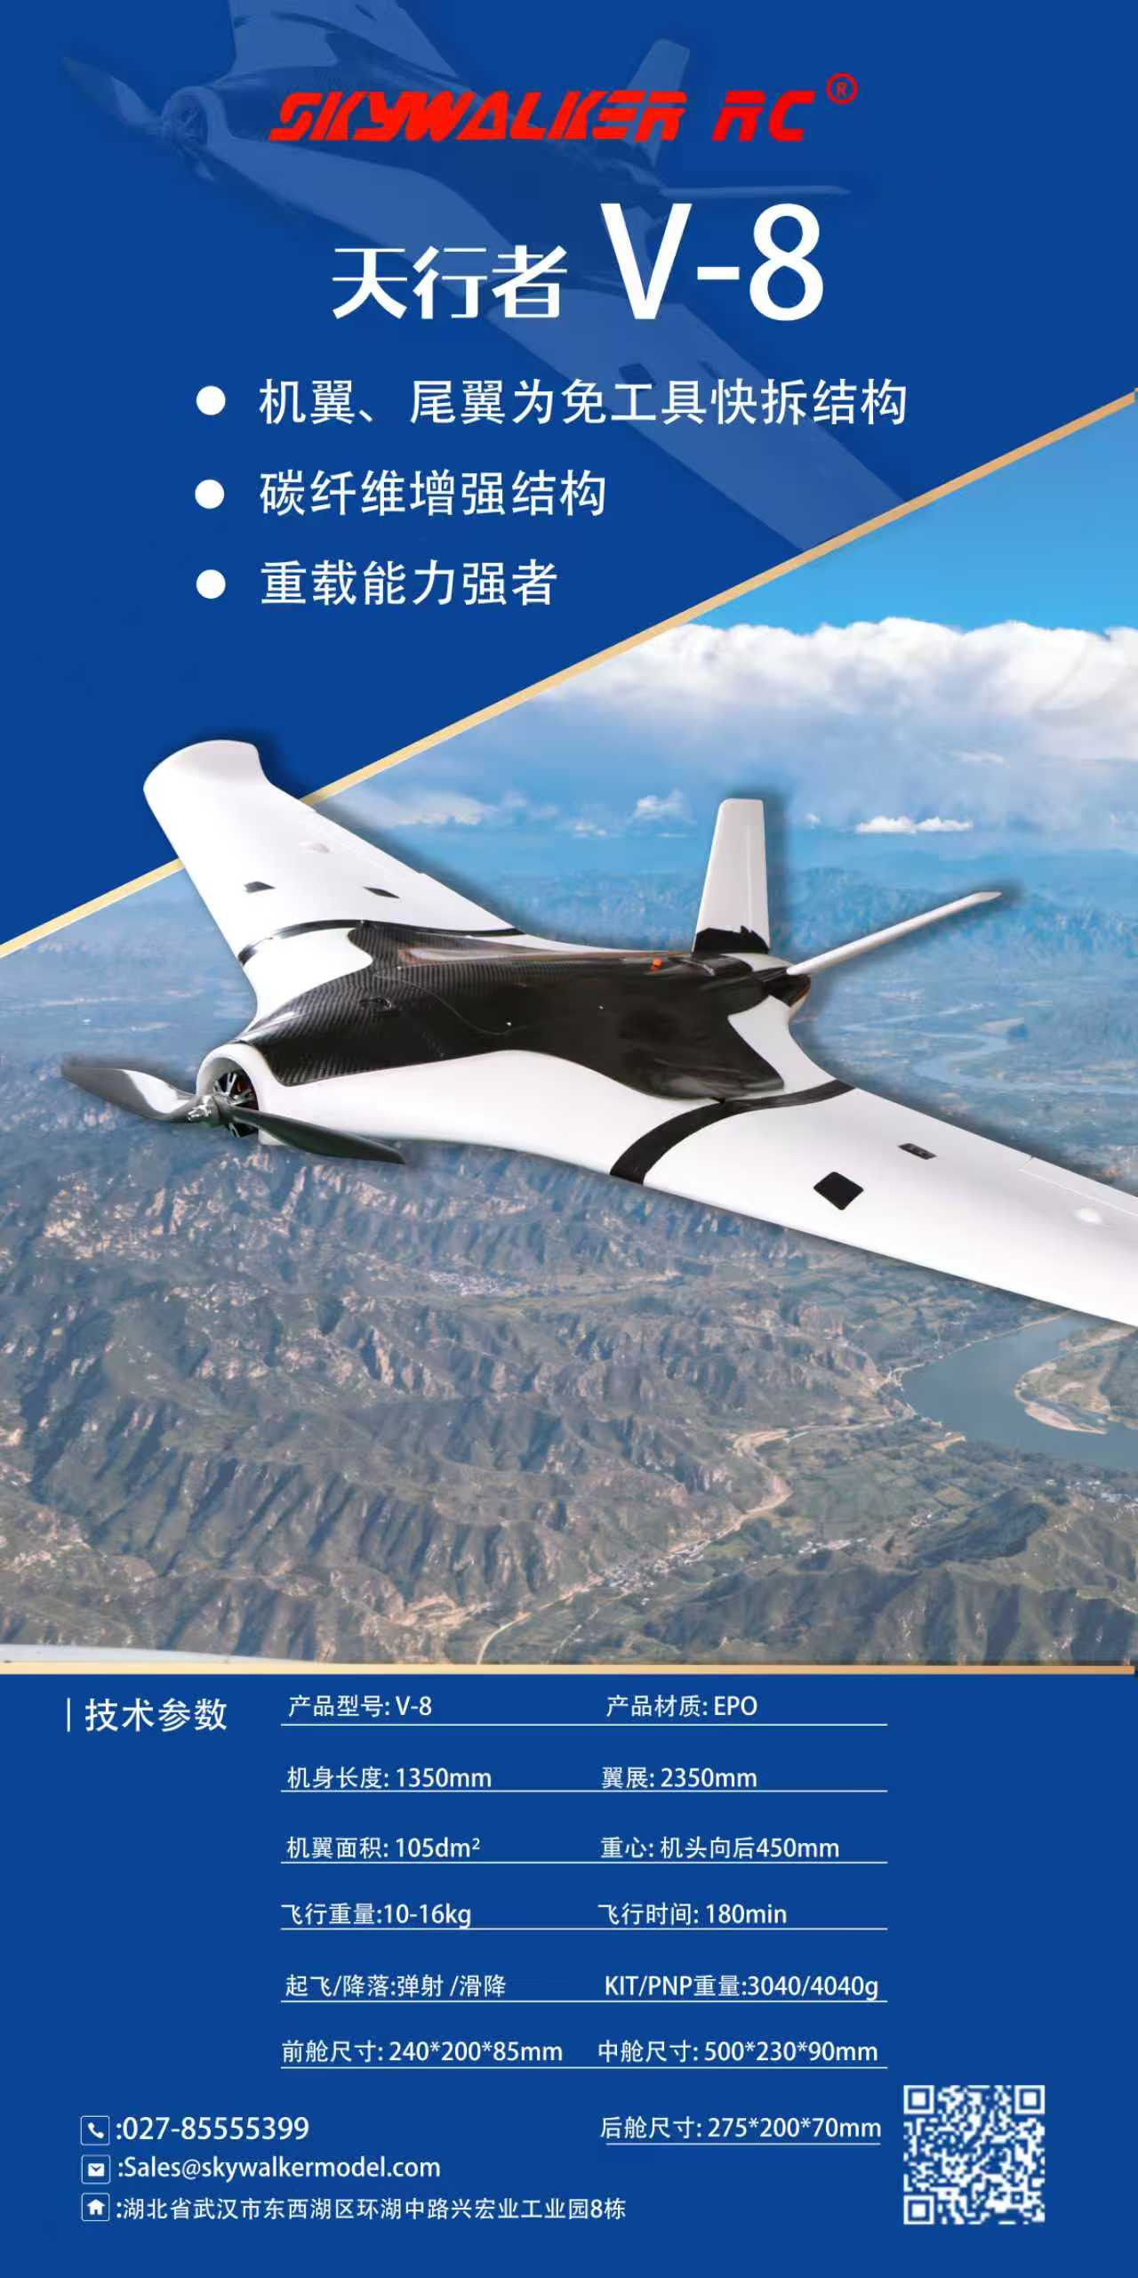
UAV COMPONENTS
XIANGFENG
Foam components for UAV applications
Custom foam components support customer projects in aerial imaging, intelligent delivery and small multipurpose transport.
Structural compatibility
Review geometry, mounting interfaces and assembly space against customer drawings. Define how foam parts fit reinforcement and connectors.
Low weight and consistency
Set targets by material grade, molded density and design. Verify weight, dimensions and appearance with first articles and samples.
Scope of supply
Agree on components, secondary processing and assembly per project. Validate complete aircraft performance and operating capability separately.
The right-hand images are application examples from the original company materials. Technical discussion points are proposed items for confirmation.
Guangxi Xiangfeng Technology Co., Ltd.
11
Notes:
来源：用户提供的广西翔丰科技有限公司.pptx、翔丰科技简介(6).docx与供应商基本信息调查表-广西.xlsx。应用海报不代表自行生产整机系统；应用类型来自原公司简介。

Slide 12
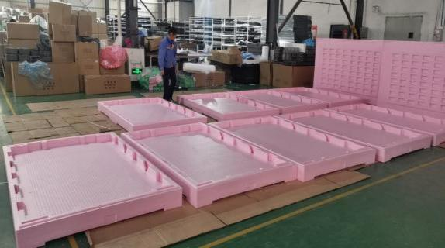
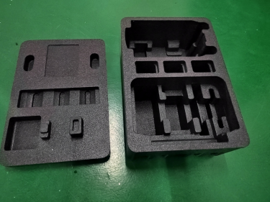
PROTECTIVE PACKAGING
XIANGFENG
Protective packaging and custom inserts
Packaging design inputs
Item dimensions, weight, center of gravity and fragile areas, plus transport method, stacking and reuse requirements.
Structural assessment
Contact and support points, cushioning space, ease of handling and the fit between the protective packaging and outer carton.
Sample validation and acceptance
Verify fit, protection and handling under agreed conditions. Arrange drop, vibration or compression tests as the project requires.
Application examples. Agree on special packaging test capability, the testing party and acceptance criteria for each project.
Guangxi Xiangfeng Technology Co., Ltd.
12
Notes:
来源：用户提供的广西翔丰科技有限公司.pptx、翔丰科技简介(6).docx与供应商基本信息调查表-广西.xlsx。行业技术参考，不代表广西翔丰已确认的材料牌号、工艺参数、检测能力或认证。具体产品按原厂TDS/SDS、客户图纸和试产结果确认。
参考资料（2026-09-22查阅）：
https://www.kaneka.com.my/product/expandable-foam/展示现有资料产品，设计和验证为项目建议。

Slide 13
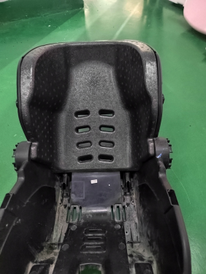
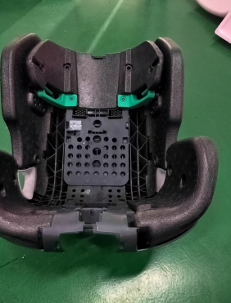
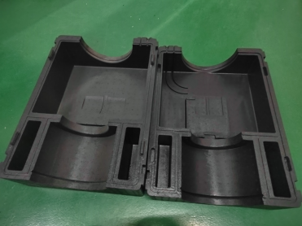
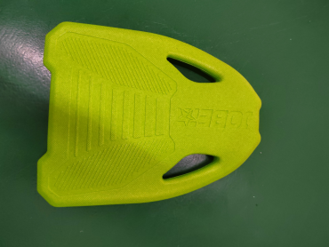
FUNCTIONAL COMPONENTS
XIANGFENG
Automotive and functional foam products
Existing product materials include seat components and complex shapes, customized to customer drawings and use requirements.
Foam seat components
Structural components
Shape, support and assembly fit
Holes, interfaces and edge details
Complex-shaped parts
Functional molded products
Recesses, thickness and demolding
Load points and service conditions
Images show example products. Confirm safety, flame resistance and other special requirements against the selected material and applicable tests.
Guangxi Xiangfeng Technology Co., Ltd.
13
Notes:
来源：用户提供的广西翔丰科技有限公司.pptx、翔丰科技简介(6).docx与供应商基本信息调查表-广西.xlsx。照片来自原PPT，依据外形命名，未推断具体认证或安全等级。

Slide 14
PROJECT DEVELOPMENT
XIANGFENG
Drawing review through production launch
Tooling and foam manufacturing teams work to the same drawing revision, samples and acceptance criteria.
Requirements review
Design & tooling
Trials & adjustments
Sample approval
Production launch
Application and quantity
Drawings and key requirements
Material and structure
Mold and machining plan
Process trials
Dimensions and appearance
Samples and measurements
Customer acceptance feedback
Process and inspection documents
Scheduling and delivery plans
Technical deliverables
Project control points
Confirm drawings, mold revisions, samples and inspection items. Propose adjustments and obtain approval for design or process constraints.
Share changes promptly with engineering, production and quality. Confirm volume supply conditions and lead times after sample approval.
Development framework: both parties agree on the schedule, acceptance milestones and documentation scope.
Guangxi Xiangfeng Technology Co., Ltd.
14
Notes:
来源：用户提供的广西翔丰科技有限公司.pptx、翔丰科技简介(6).docx与供应商基本信息调查表-广西.xlsx。行业技术参考，不代表广西翔丰已确认的材料牌号、工艺参数、检测能力或认证。具体产品按原厂TDS/SDS、客户图纸和试产结果确认。
参考资料（2026-09-22查阅）：
https://www.arpro.com/product/product-services/industrial-engineering
https://www.arpro.com/product/product-services开发与协同流程为建议方案。

Slide 15
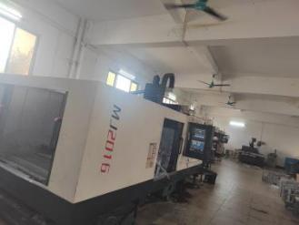
TOOLING & DESIGN
XIANGFENG
Mold design and manufacturability
Foam part dimensions, appearance and process stability depend on the product design, mold layout and molding process working together.
01
Wall thickness and local features
Assess thin walls, deep cavities and corners against bead size.
02
Filling and venting layout
Consider filling paths, steam flow, venting and visible surfaces.
03
Parting and demolding
Assess parting surfaces, demolding direction and ejector positions.
Aluminum alloy molds and CNC machining
04
Shrinkage and dimensional acceptance
Assess the mold concept against product drawings. Use mold trials to confirm actual manufacturing conditions.
Validate shrinkage and tolerances for the material, design and actual process.
Industry design reference: JSP Basic Design Guide. Product validation determines specific tolerances and mold parameters.
Guangxi Xiangfeng Technology Co., Ltd.
15
Notes:
来源：用户提供的广西翔丰科技有限公司.pptx、翔丰科技简介(6).docx与供应商基本信息调查表-广西.xlsx。行业技术参考，不代表广西翔丰已确认的材料牌号、工艺参数、检测能力或认证。具体产品按原厂TDS/SDS、客户图纸和试产结果确认。
参考资料（2026-09-22查阅）：
https://www.omnipack.eu/files/dokumenty/arpro-basic-design-guide.pdf
https://www.arpro.com/product/product-services

Slide 16
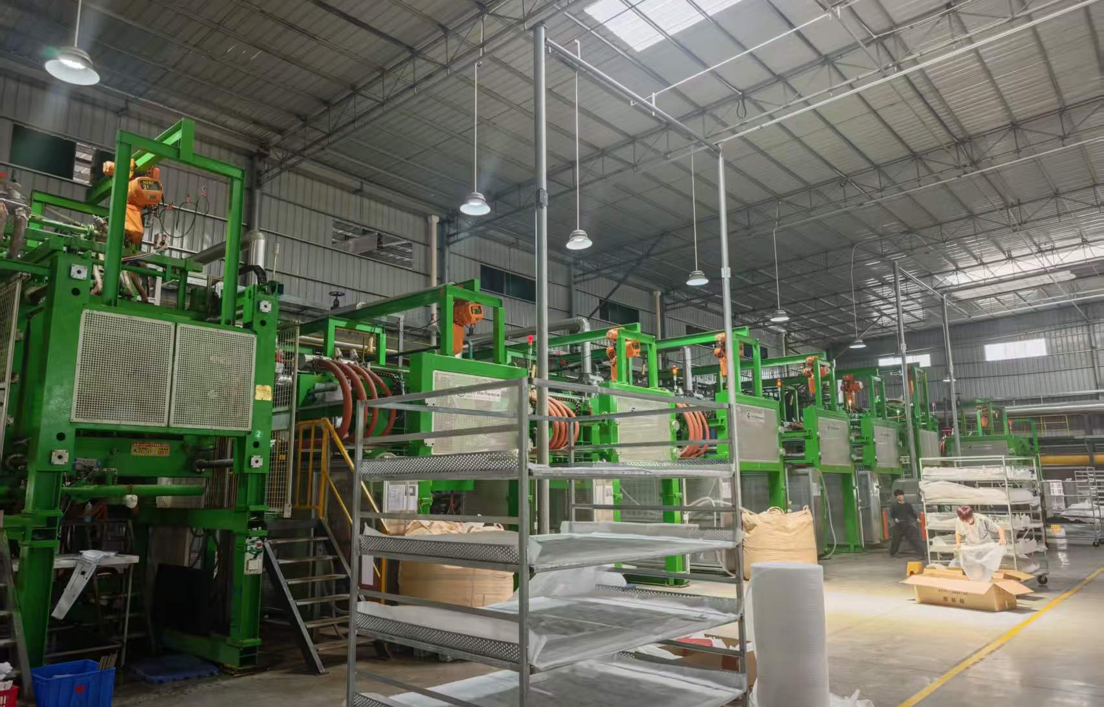
EQUIPMENT
XIANGFENG
Molding equipment and production support
16
Molding machines
Machine and mold compatibility
Assign machines according to product geometry, mold dimensions and process requirements.
Production preparation
Check materials and molds against the work order. Confirm machine condition and work instructions.
Guangxi Xiangfeng production site. Output per shift and cycle time depend on the product, mold cavities and processing conditions.
Guangxi Xiangfeng Technology Co., Ltd.
16
Notes:
来源：用户提供的广西翔丰科技有限公司.pptx、翔丰科技简介(6).docx与供应商基本信息调查表-广西.xlsx。各材料来源对设备型号分配存在差异，因此仅保留一致的总数量16。

Slide 17
PRODUCTION FLOW
XIANGFENG
Production process overview
This reference route uses purchased expanded beads and connects material preparation, first-article approval and volume production release.
Drawings & material
IQC & storage
Material & mold setup
Pretreatment if needed
Grade, specifications and acceptance
Lot, appearance and documents
Work order, mold and machine
By grade and filling method
Cooling & demolding
Molding cycle
First-article release
Mold trial & first article
Remove parts at the required state
Filling, steam fusion and other steps
Approval before volume production
Trial run and critical checks
Stabilization / treatment
Trimming & sorting
Final check & packing
Storage & dispatch
Based on material and design
Appearance, model and quantity
Release after acceptance
Labels, quantity and consignee
First-article or patrol inspection issue: stop affected work, segregate suspect products and release only after assessment, adjustment and reinspection.
Illustrative process. Pretreatment, stabilization and post-treatment are not necessary for every product. Confirm EPO processing by grade and approved instructions.
Guangxi Xiangfeng Technology Co., Ltd.
17
Notes:
来源：用户提供的广西翔丰科技有限公司.pptx、翔丰科技简介(6).docx与供应商基本信息调查表-广西.xlsx。行业技术参考，不代表广西翔丰已确认的材料牌号、工艺参数、检测能力或认证。具体产品按原厂TDS/SDS、客户图纸和试产结果确认。
参考资料（2026-09-22查阅）：
https://www.arpro.com/contentassets/0ed490e3594146aaacb8a00e99b984c8/techdoc_productprocessingguideline-epp_2018.pdf
https://www.arpro.com/product/product-services/process-proceduresEPP以采购发泡珠粒加工的典型路线为参考；EPO工艺须按具体牌号确认。

Slide 18
EPP SHAPE MOULDING
XIANGFENG
EPP steam molding: one production cycle
Expanded beads enter the mold cavity. Steam transfers heat to fuse them, then cooling and demolding produce the finished shape.
01 Mold preparation
02 Bead filling
03 Steam fusion
Check mold, filling and steam conditions.
Confirm connections, seals and settings.
Fill the cavity with expanded beads.
Use crack-gap or pressure filling as specified.
Heat bonds beads at their contact points.
Set conditions for material, density and geometry.
06 Cycle checks
05 Demolding
04 Cooling & stabilization
Check part weight, appearance and process status.
Report issues and restore controlled production.
Remove the part when conditions are suitable.
Protect weak areas and check initial appearance.
Remove heat and reduce internal pressure.
Even cooling helps prevent distortion and demolding issues.
Industry reference: JSP. The cycle describes principles, not a universal recipe. Validate temperature, pressure and time for the grade, machine and mold.
Guangxi Xiangfeng Technology Co., Ltd.
18
Notes:
行业技术参考，不代表广西翔丰已确认的材料牌号、工艺参数、检测能力或认证。具体产品按原厂TDS/SDS、客户图纸和试产结果确认。
参考资料（2026-09-22查阅）：
https://www.arpro.com/contentassets/0ed490e3594146aaacb8a00e99b984c8/techdoc_productprocessingguideline-epp_2018.pdf
https://www.arpro.com/getContentAsset/648e1b52-840b-4264-8b2f-6cc4f401d127/1771ac74-d775-4539-b7e3-0cbf0ab84455/arpro-5130-datasheet-v09-en.pdf?language=en-GB
https://www.arpro.com/contentassets/9fb5fdf034884d72953cea3c5a70d3ad/arpro-5150-datasheet-v05-en.pdf常见循环原理示意，非翔丰机台操作规程。

Slide 19
PRE- & POST-TREATMENT
XIANGFENG
Pretreatment, stabilization and post-treatment
Before molding: bead pretreatment
After molding: stabilization and treatment
Some materials receive air-pressure treatment before molding to adjust the internal bead condition for filling and target density. The grade and process determine whether treatment is needed.
Parts must reach a stable condition for inspection and use. Heat treatment can help some products lose moisture and recover shape. Specify measurement timing and treatment conditions in the process instructions.
Manufacturer example | Treatment in manufacturer documents | Implications for technical discussions
ARPRO 5130 Version 09 | For specified low molded densities and dimensions, thermal post-treatment is recommended | Confirm against target density, design and actual trial results
ARPRO 5150 Version 05 | Generally no thermal post-treatment. Stabilize before measuring. Highly compressed products still require post-treatment | One grade's treatment approach cannot be applied to all EPP products
Validate by grade. Assess samples and dimensions under consistent conditions.
Source: JSP data sheets. These are manufacturer examples, not Xiangfeng's material list. Confirm actual parameters against supplier data and process validation.
Guangxi Xiangfeng Technology Co., Ltd.
19
Notes:
行业技术参考，不代表广西翔丰已确认的材料牌号、工艺参数、检测能力或认证。具体产品按原厂TDS/SDS、客户图纸和试产结果确认。
参考资料（2026-09-22查阅）：
https://www.arpro.com/getContentAsset/648e1b52-840b-4264-8b2f-6cc4f401d127/1771ac74-d775-4539-b7e3-0cbf0ab84455/arpro-5130-datasheet-v09-en.pdf?language=en-GB
https://www.arpro.com/contentassets/9fb5fdf034884d72953cea3c5a70d3ad/arpro-5150-datasheet-v05-en.pdf仅用于说明不同材料和工况需要不同处理，不给出未经确认的翔丰参数。

Slide 20
QUALITY CAPABILITY
XIANGFENG
Quality inspection team and measuring tools
Professional inspectors apply quality requirements throughout incoming materials, production, finished goods and dispatch.
Incoming quality
Process supervision
Delivery verification
Check material lots and status
First-article and patrol checks
Final and outgoing inspections
Measuring tool | Main use | Inspection considerations
Vernier caliper | Critical dimensions and local features | Drawing datums, tolerances and measurement locations
Electronic scale | Part weight and lot weight verification | Weighing conditions, target weight and variation
Tape measure | Overall length and larger dimensions | Overall dimensions, packaging and assembly requirements
Measuring tools and records
Check tool condition before use. Apply consistent measurement datums and record the lot, results and disposition.
Tool types follow the supplier questionnaire. Controlled documents govern gauge management and inspection. Confirm special tests against product requirements.
Guangxi Xiangfeng Technology Co., Ltd.
20
Notes:
来源：用户提供的广西翔丰科技有限公司.pptx、翔丰科技简介(6).docx与供应商基本信息调查表-广西.xlsx。用户要求：不显示质检人数和工具数量，突出多名专业质检人员及多种工具。仅使用调查表确认的游标卡尺、电子秤、卷尺；不扩充未证实设备。

Slide 21
QUALITY PROCESS
XIANGFENG
Quality inspection and release workflow
Each inspection defines standards, records and release conditions. Segregate nonconforming items and return them to the process only after successful reinspection.
Incoming inspection (IQC)
First-article approval
In-process inspection (IPQC)
Final inspection (FQC)
Outgoing inspection (OQC)
Lot, appearance and documents
Use materials only after approval
Sample, weight and dimensions
Approve before volume production
Patrol checks and process records
Monitor process changes
Appearance, weight and dimensions
Check stability and assembly
Model, quantity and packaging
Verify the order and labels
Any failed inspection triggers nonconformance handling
Identify & segregate
Review & disposition
Reinspection
Return to process
Keep separate from accepted goods
Return, rework or approved action
Inspect again and record the result
Release after successful reinspection
Link inspection lots, acceptance criteria, results, nonconformance actions and release status in the records.
Inspection framework: actual procedures and customer requirements determine sampling, frequency, acceptance criteria and approval authority.
Guangxi Xiangfeng Technology Co., Ltd.
21
Notes:
来源：用户提供的广西翔丰科技有限公司.pptx、翔丰科技简介(6).docx与供应商基本信息调查表-广西.xlsx。按用户要求设计质量流程。流程方案须与实际受控程序和产品检验规范衔接，不新增专项检测能力。

Slide 22
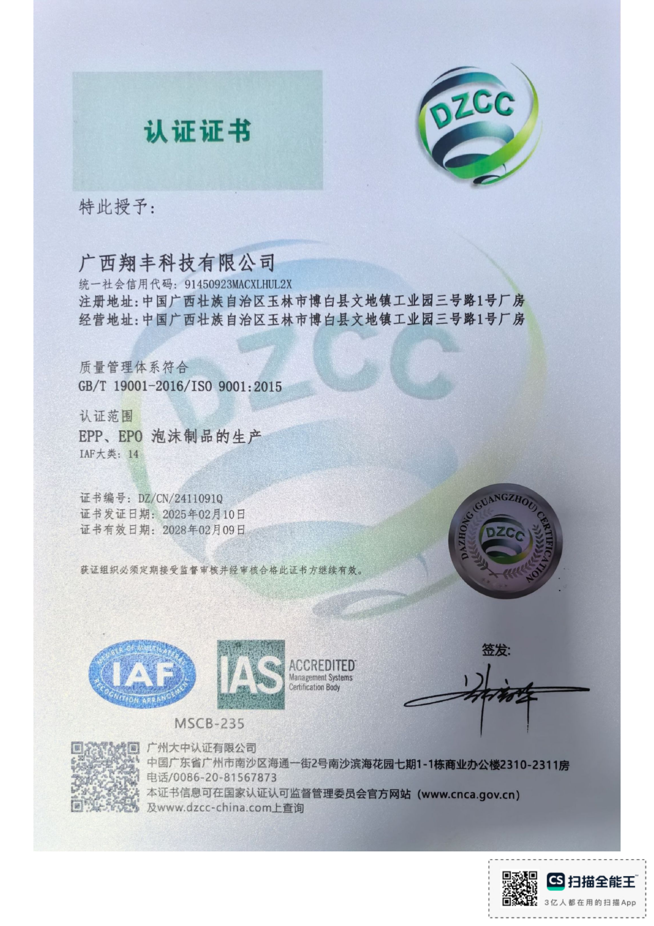
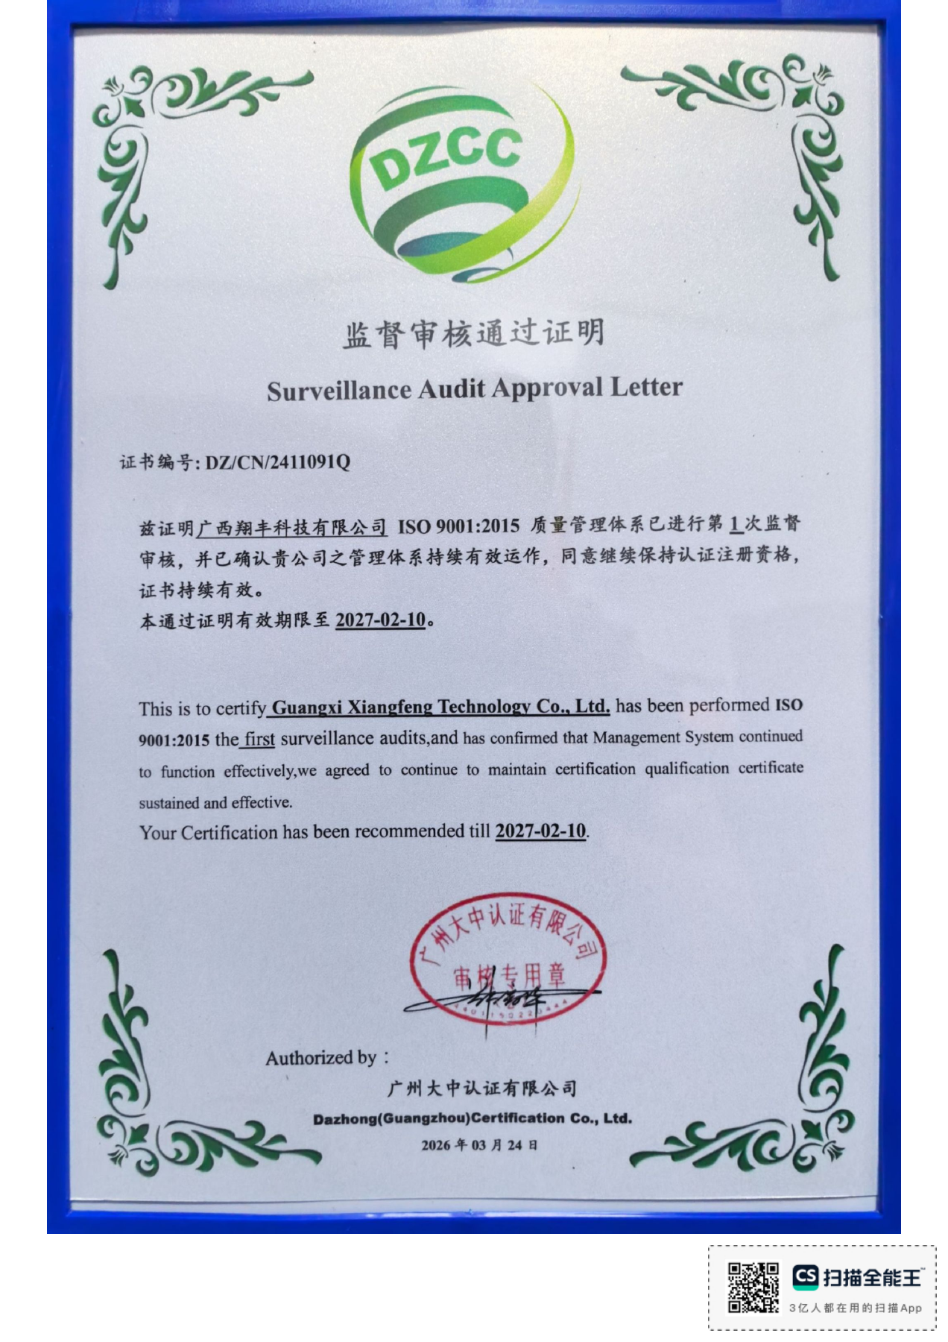
QUALITY CERTIFICATION
XIANGFENG
ISO 9001 quality management certification
Certified organization
Guangxi Xiangfeng Technology Co., Ltd.
Standard and scope
ISO 9001:2015
Production of EPP and EPO foam products
Certificate details
No. DZ/CN/2411091Q
Certificate valid until 9 February 2028
Surveillance audit
First surveillance audit passed
Statement valid until 10 February 2027
Original certificate and surveillance statement shown. Continued certification depends on surveillance audits required by the certification body.
Guangxi Xiangfeng Technology Co., Ltd.
22
Notes:
来源：D:/My Data/翔丰/广西翔丰/证书/ISO9001.pdf，第1页中文证书、第3页监督审核通过证明。证书编号DZ/CN/2411091Q，标准GB/T 19001-2016/ISO 9001:2015；证载有效期2025-02-10至2028-02-09；监督证明2026-03-24签发，有效至2027-02-10。根据本地原件展示，未声称在线核验结果。

Slide 23
5S WORKPLACE MANAGEMENT
XIANGFENG
5S workplace management and improvement
Apply standards for work areas, materials, tools and operations. Daily checks support corrective action and consistent work habits.
5S element | Workplace implementation | Visual controls and inspection points
Sort | Separate needed items from unneeded ones. Remove idle and unusable materials. | Red tags, holding areas and disposition records
Set in order | Assign tool positions and material areas. Keep access and aisles clear. | Area markings, location labels, status and lot identification
Shine | Remove beads, dust and debris. Use equipment cleaning to identify issues. | Cleaning checks for machines, floors and material areas
Standardize | Standardize sorting, storage and cleaning requirements. | Photo standards, assigned areas and checklists
Sustain | Conduct role-based training, handover checks and daily self-checks. | Execution records, issue feedback and corrective-action reviews
Assign work areas
Daily checks
Record issues
Correct by deadline
Recheck & sustain
5S framework: actual site rules define check frequency, responsible roles and deadlines. Include safety in daily checks.
Guangxi Xiangfeng Technology Co., Ltd.
23
Notes:
用户要求设计5S管理；现场文化来自宣传图2.jpg。5S原理参考https://www.epa.gov/sustainability/lean-energy-toolkit-chapter-5 。以下为管理展示方案，不虚构检查评分和实施结果。

Slide 24
PROCESS TROUBLESHOOTING
XIANGFENG
Common molding issues and troubleshooting
Retain affected samples and lot, machine and mold information. Use process records to verify the cause.
Symptom | Priority checks | Validation or corrective action
Short fill / incomplete areas | Material supply, filling paths and local geometry Filling and venting condition | Check conditions at the defect location Reapprove the first article after adjustment
Poor bead fusion | Material condition and steam flow Compatibility of fusion conditions and pretreatment | Verify by cross-section or an agreed method Validate adjustments through trials
Shrinkage / warpage | Cooling uniformity and condition at demolding Design, stabilization and post-treatment conditions | Use consistent measurement timing and datums Compare process and sample records
Weight / dimensional variation | Material lots, filling and process variation Measurement method and part stabilization | Verify gauges and methods Remeasure and analyze process trends
Surface / demolding damage | Parting, ejection and handling methods Mold surface, contamination and cleanliness | Distinguish tooling, molding and handling causes Validate appearance samples after correction
Industry guidance: symptoms do not establish causes. Technical staff must use manufacturer data and on-site validation before adjusting parameters.
Guangxi Xiangfeng Technology Co., Ltd.
24
Notes:
行业技术参考，不代表广西翔丰已确认的材料牌号、工艺参数、检测能力或认证。具体产品按原厂TDS/SDS、客户图纸和试产结果确认。
参考资料（2026-09-22查阅）：
https://www.arpro.com/contentassets/0ed490e3594146aaacb8a00e99b984c8/techdoc_productprocessingguideline-epp_2018.pdf
https://www.arpro.com/contentassets/9fb5fdf034884d72953cea3c5a70d3ad/arpro-5150-datasheet-v05-en.pdf
https://www.omnipack.eu/files/dokumenty/arpro-basic-design-guide.pdf
https://www.arpro.com/innovation-services/deployment/advanced-quality-measurement表格为依据公开原理整理的排查建议，各现象可能对应多种原因，不能代替现场诊断。

Slide 25
TRACEABILITY & IMPROVEMENT
XIANGFENG
Issue resolution and lot traceability
Link issue handling to lot information to define the affected scope, disposition and reinspection results.
Detect & record
Segregate & assess
Analyze & act
Recheck & close
Describe the issue and impact
Distinguish product status
Identify causes and actions
Verify results and give feedback
If reinspection fails, repeat analysis and action. When it passes, communicate the relevant operating requirements.
Suggested traceability records
Orders and drawings
Order number, product code, drawing and sample revisions
Materials and production
Material grade / lot, machine, mold, work order and production time
Inspection and delivery
First-article and inspection results, issue disposition, labels and dispatch lots
Management framework: actual procedures and project agreements define record formats, retention and customer traceability scope.
Guangxi Xiangfeng Technology Co., Ltd.
25
Notes:
来源：用户提供的广西翔丰科技有限公司.pptx、翔丰科技简介(6).docx与供应商基本信息调查表-广西.xlsx。异常与追溯为管理建议方案。

Slide 26
SERVICE TEAM
XIANGFENG
Responsive and accountable project service
Within 48 hours
Coordinated project support
Sales gathers requirements. Engineering, production and quality follow up together.
Response to service requests and complaints
Progress and results
Identify open points and responsible departments. Keep customers informed of progress and outcomes.
Request received
Internal review
Proposed plan
Follow-through
Drawings, samples and timing
Engineering, production and quality
Conditions, schedule and open points
Confirm results and ongoing support
Response time follows the supplier questionnaire. Communicate resolution progress and completion timing according to the actual situation.
Guangxi Xiangfeng Technology Co., Ltd.
26
Notes:
来源：用户提供的广西翔丰科技有限公司.pptx、翔丰科技简介(6).docx与供应商基本信息调查表-广西.xlsx。48小时为响应时限，不是问题解决时限。不展示业务联系人、个人姓名或手机号码。

Slide 27
CUSTOMER RELATIONSHIPS
XIANGFENG
Supplier to multiple listed companies
Building on Guangzhou Xiangfeng's customer relationships, the business serves listed companies and customers in model aircraft, UAVs and other sectors.
Goertek
TCL CSOT
Model aircraft and hobby models
UAV sector
FMS
Skywalker
Feima Robotics
Google Wing
Hangzhou
Zhongtian Model
Shengteng
Aviation Models
Diaopu UAV
Selected customers include relationships developed during the Guangzhou Xiangfeng period. Agreements define the supplying entity, project scope and trading relationship.
Guangxi Xiangfeng Technology Co., Ltd.
27
Notes:
来源：用户提供的广西翔丰科技有限公司.pptx、翔丰科技简介(6).docx与供应商基本信息调查表-广西.xlsx。优秀供应商为用户明确陈述，非特定获奖声明。列名含广州翔丰阶段积累，并非全部客户均为上市公司。

Slide 28
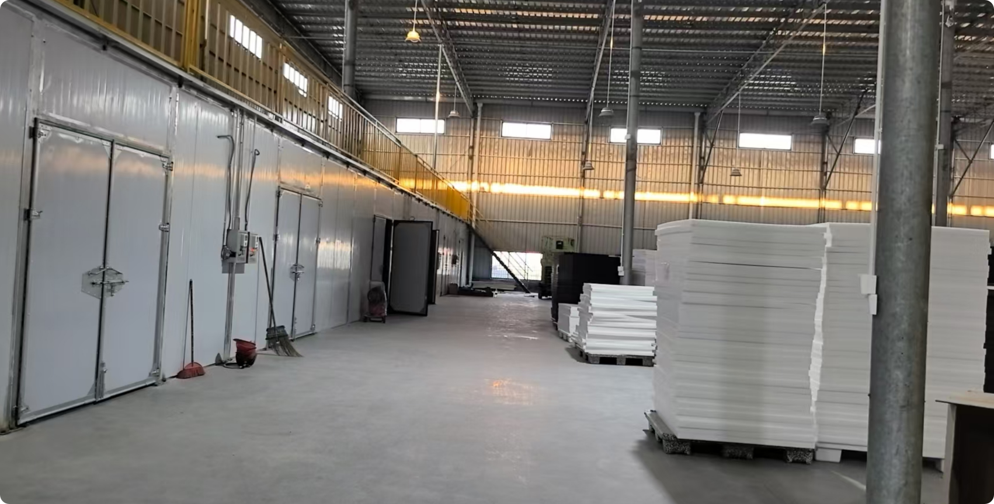
PACKAGING & DELIVERY
XIANGFENG
Packaging, storage and delivery management
Packaging approval
Confirm high-density plastic bags, cartons and other packaging against appearance protection, pack quantity and transport conditions.
Labels and quantities
Check product model, lot, quantity and consignee details. Keep packaging status consistent with the dispatch list.
Dispatch and handover
Finished goods storage and handling
Coordinate dispatch and arrival information through third-party logistics. Confirm delivery timing by order, mold status and production schedule.
Separate by model, status and lot. Arrange protection and stacking to suit the product design.
Storage, packaging labels and delivery requirements follow the specific project agreement.
Guangxi Xiangfeng Technology Co., Ltd.
28
Notes:
来源：用户提供的广西翔丰科技有限公司.pptx、翔丰科技简介(6).docx与供应商基本信息调查表-广西.xlsx。包装方式和第三方物流据调查表，记录安排为管理方案。

Slide 29
INBOUND & MATERIAL CONTROL
XIANGFENG
Incoming storage and material issue workflow
Use purchasing information, incoming inspection and lot identification to distinguish pending, accepted and nonconforming materials.
Pass
Receive delivery
Register for inspection
IQC inspection
Accepted into stock
Issue to work order
Check purchase / delivery documents
Material, lot, packaging and quantity
Apply incoming inspection standards
Record location, lot and status
Check work order and issue details
Fail
Inventory management
Segregate & notify
Return / review
Use designated material areas, lot identification and FIFO where applicable. Record issues and returns promptly to keep records, stock and status aligned.
Mark pending status and notify relevant teams
Store after successful reinspection
Link receiving records, locations / lots, material issue orders and production lots to trace material movement.
Storage and issue framework: apply any special storage, shelf-life or customer-designated lot requirements.
Guangxi Xiangfeng Technology Co., Ltd.
29
Notes:
来源：用户提供的广西翔丰科技有限公司.pptx、翔丰科技简介(6).docx与供应商基本信息调查表-广西.xlsx。按用户要求设计入库与领料流程。数量核对是业务检查事项，不表示人员或工具数量。

Slide 30
FINISHED GOODS & OUTBOUND
XIANGFENG
Finished goods storage and dispatch workflow
Store finished goods after inspection approval. Pick by order, complete outgoing checks and hand over to logistics.
After approval
Final inspection
Accepted into stock
Pick to order
Pack & box
Appearance, dimensions and weight
Model, lot and status
Stock and delivery plan
Protection and packing list
Delivery follow-up
Logistics handover
Dispatch check
Outgoing inspection (OQC)
Receipt and issue feedback
Carrier details and handover records
Documents, goods and quantity
Order, quantity and package labels
Nonconformance control
Stop movement and segregate items if inspection or verification fails. Release after correction, reinspection and renewed approval.
Finished goods and dispatch framework: customer requirements and actual procedures govern release, package labels and handover records.
Guangxi Xiangfeng Technology Co., Ltd.
30
Notes:
来源：用户提供的广西翔丰科技有限公司.pptx、翔丰科技简介(6).docx与供应商基本信息调查表-广西.xlsx。按用户要求设计成品入库、出库及交接流程，与原资料的纸箱／塑料袋及第三方物流衔接。

Slide 31
PROJECT INPUTS
XIANGFENG
Project coordination and required inputs
Complete initial information supports faster feasibility reviews, quotations and sample development.
Customer inputs / approval | Specific information | Xiangfeng's review focus
Product & application | 2D / 3D drawings, samples and use cases Visible surfaces and critical mounting interfaces | Manufacturability and mold concept
Material & performance | Material grade or target properties and color Density / weight and special requirements | Material selection and required validation
Quality & acceptance | Critical dimensions, tolerances and appearance samples Test conditions, acceptance criteria and documentation | First-article approval and inspection plan
Quantity & delivery | Sample quantity, volume demand and delivery schedule Packaging labels, shipping and receiving requirements | Development schedule, production and logistics coordination
Main deliverables
Molds / samples, accepted products and the inspection and delivery documents agreed for the project.
Guangxi Xiangfeng Technology Co., Ltd.
31
Notes:
来源：用户提供的广西翔丰科技有限公司.pptx、翔丰科技简介(6).docx与供应商基本信息调查表-广西.xlsx。此页为项目对接建议，不是现有客户已提供的资料。

Slide 32
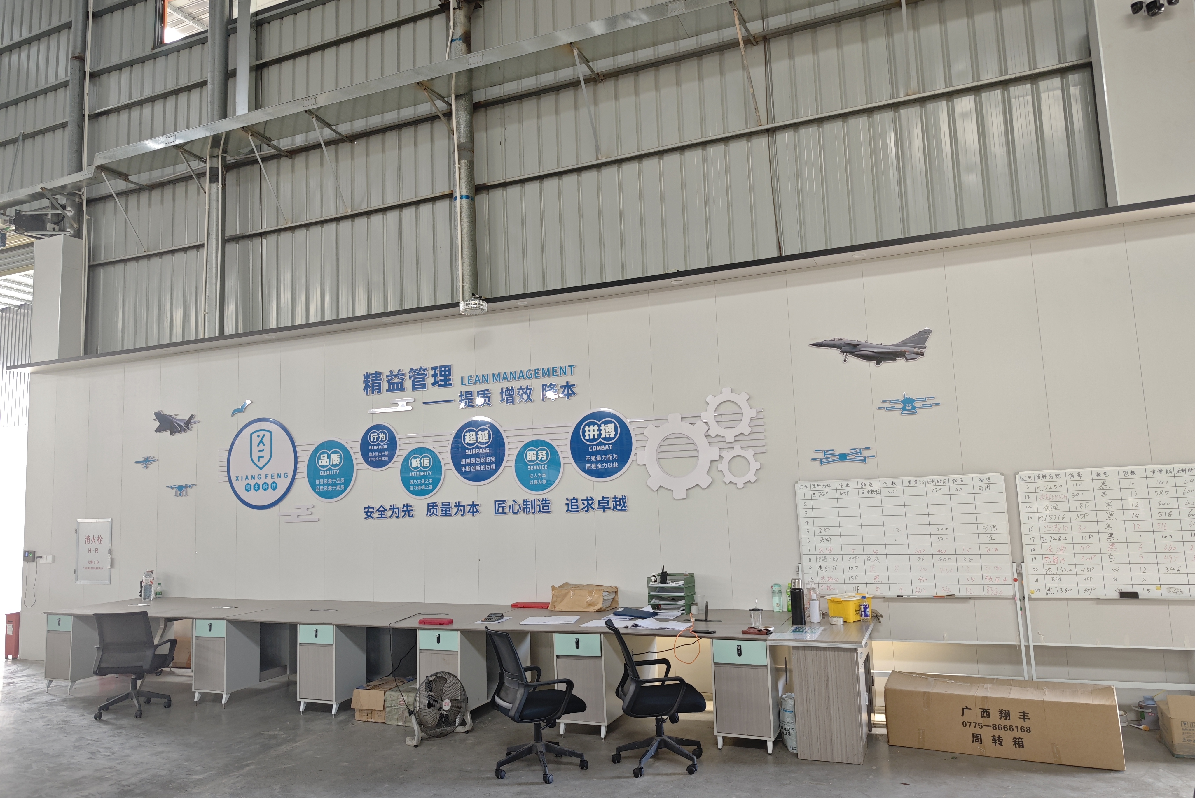
COOPERATION VALUE
XIANGFENG
Lean management and customer value
Manufacturing foundation
An operating 20,000+ m² base with RMB 30 million in fixed assets, supported by dedicated tooling and foam workshops.
Technical support
Mold design, CNC machining and molding teams coordinate around drawings, samples and manufacturing conditions.
Accountable service
Named contacts, technical follow-up and timely feedback assign clear responsibility for requirements review and delivery communication.
Safety first, quality at the core. Site management and team coordination support customer projects.
Guangxi Xiangfeng Technology Co., Ltd.
32
Notes:
来源：用户提供的广西翔丰科技有限公司.pptx、翔丰科技简介(6).docx与供应商基本信息调查表-广西.xlsx。宣传图2.jpg显示现场精益管理及质量文化。技术参考链接汇总：
epp: https://www.kaneka.com.my/product/expandable-foam/
epo: https://support.fmshobby.com/hc/en-us/articles/28297346222484-FMS-EPO-Foam-Expanded-Polyolefin-in-RC-Aircraft-Models
epodesign: https://www.fmshobby.com/es/blogs/rc-airplanes/best-beginner-rc-plane-selection-guide
process: https://www.arpro.com/contentassets/0ed490e3594146aaacb8a00e99b984c8/techdoc_productprocessingguideline-epp_2018.pdf
design: https://www.omnipack.eu/files/dokumenty/arpro-basic-design-guide.pdf
grade5130: https://www.arpro.com/getContentAsset/648e1b52-840b-4264-8b2f-6cc4f401d127/1771ac74-d775-4539-b7e3-0cbf0ab84455/arpro-5130-datasheet-v09-en.pdf?language=en-GB
grade5150: https://www.arpro.com/contentassets/9fb5fdf034884d72953cea3c5a70d3ad/arpro-5150-datasheet-v05-en.pdf
grades: https://www.arpro.com/product/technical-resources/technical-document-listing
quality: https://www.arpro.com/innovation-services/deployment/advanced-quality-measurement
engineering: https://www.arpro.com/product/product-services/industrial-engineering
procedures: https://www.arpro.com/product/product-services/process-procedures
support: https://www.arpro.com/product/product-services
basf: https://www.basf.com/dk/en/media/news-releases/2020/03/p-20-157

Slide 33
We look forward
to working with you
Guangxi Xiangfeng Technology Co., Ltd.
EPP / EPO Foam Products
Tooling Development and Manufacturing
Email
open@gx-xiangfeng.com
Address
Building 1, No. 3 Road, Wendi Industrial Park, Bobai County, Yulin, Guangxi, China
Guangxi Xiangfeng Technology Co., Ltd.
33
Notes:
来源：用户提供的广西翔丰科技有限公司.pptx、翔丰科技简介(6).docx与供应商基本信息调查表-广西.xlsx。按用户要求移除业务联系人、个人姓名与手机号码，仅保留企业邮箱和地址。

